Slide 1
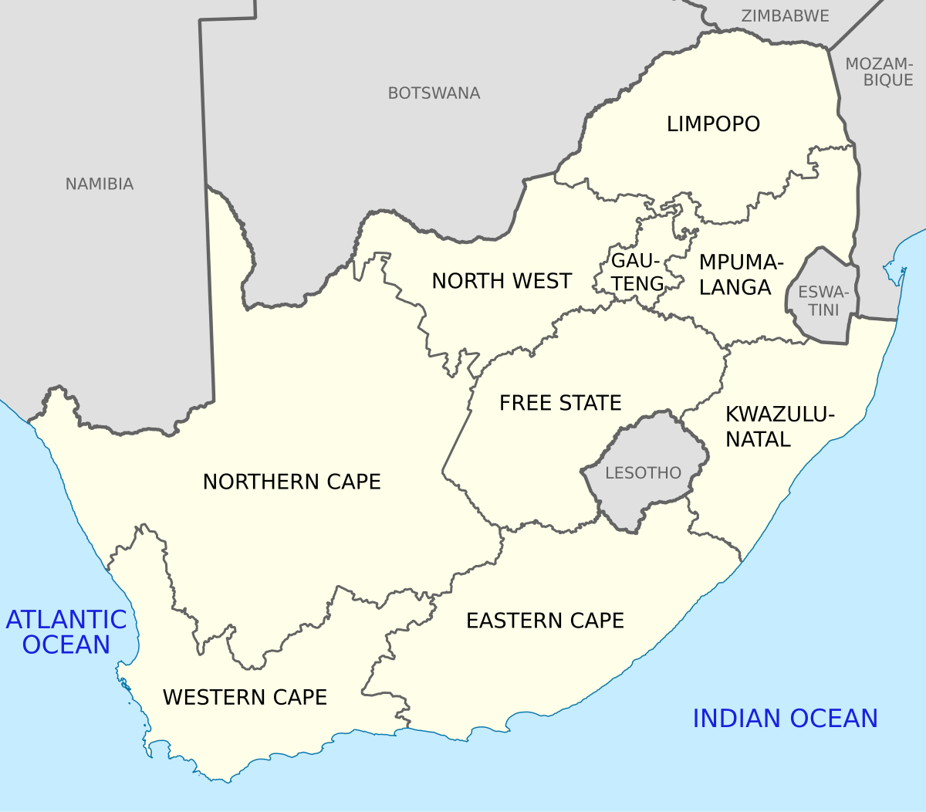
THE IMPACT OF CYBERSECURITY AND CYBERCRIME
ON THE SOUTH AFRICAN Retail Value Chain
Consumer Goods Council of South Africa
14 May 2025
Kiru Pillay
Department of Communications and Digital Technologies

Slide 2
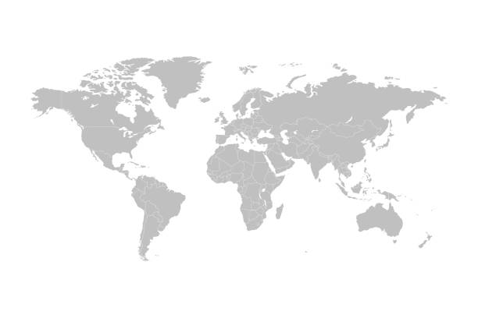
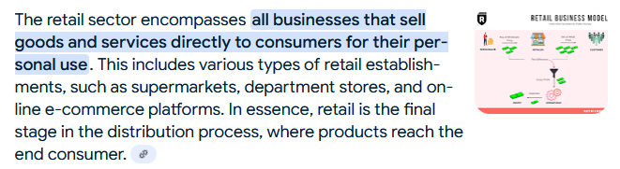
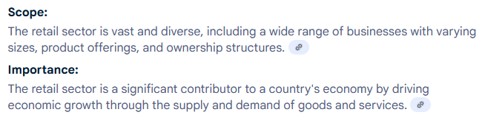
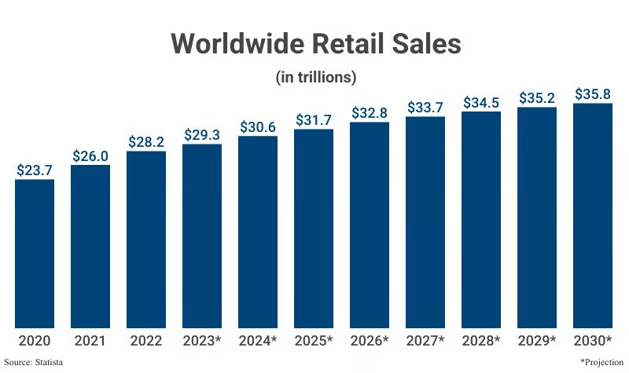

Global Retail Sector…
Worldwide retail sales totaled $30.6 trillion in 2024; projections indicate that by 2030, global retail sales will exceed $35.8 trillion.
U.S. retail sales totaled $7.26 trillion in 2024; projections indicate U.S. sales will surpass $8.29 trillion by 2030.
134.6 million primary household shoppers patronize 1.08 million stores* in the United States.
Worldwide, online shopping revenue totaled $6.01 trillion in 2024; projections indicate revenue will exceed $8.91 trillion in 2030.

Slide 3
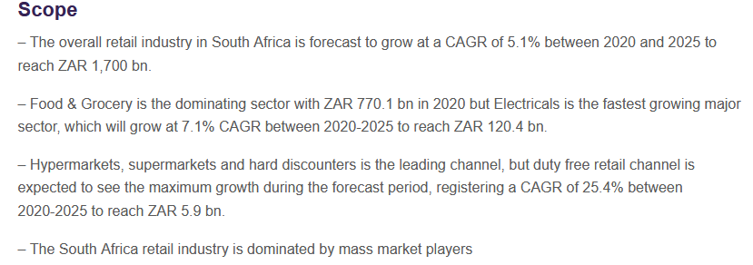

Retail Sector in South Africa…
The South Africa retail market size was ZAR1.61 trillion in 2022 and will grow at a CAGR of more than 4% during 2022-2027.
Retail in South Africa will be driven by inflation and economic recovery.
Hypermarkets and supermarkets growing share of food & grocery, but online penetration is still very low.
Key sectors
  Food & Grocery
  Home
  Health & Beauty
  Electricals
  Clothing & Footwear
Online electrical sales share of South Africa is expected to reach more than 20% in 2027, the highest among all sectors.
Home sector sales to grow significantly by 2027.
  Key Distribution Channels
  Hypermarkets, Supermarkets & Hard Discounters
  Convenience Stores (Including Independents) and Gas Stations
  Food and Drinks Specialists
  Drug Stores and Health & Beauty Stores
  Electrical and Electronics Specialists
  Clothing, Footwear, and Accessories Specialists
  Home Improvement and Gardening Supplies Specialists
  Online

Slide 4
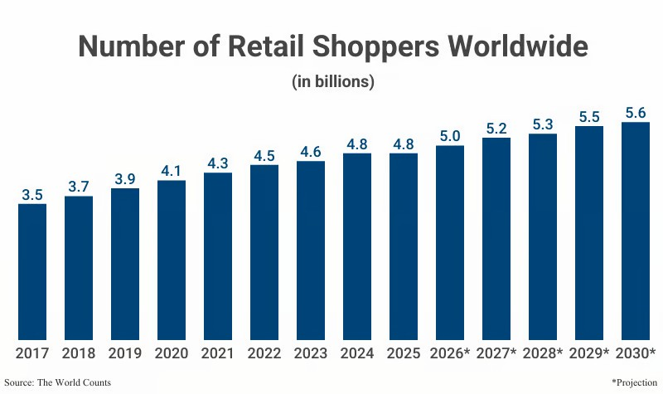
Cybersecurity, Cybercrime….
As of 2025, there are over 4.84 billion consumers or retail shoppers worldwide
Projections indicate there will be 5.6 billion by 2030.
The number of global consumers increased at an average annual rate of 5.41% from 2017 (3.5 billion) to 2023
Routine Activity Theory
Criminological routine activity theory proposes that crime risk increases upon the convergence of a motivated offender, a suitable target and the absence of a capable guardian

Slide 5
What is Cybersecurity?
Something that relates to or has the characteristic of the culture of computers, information technology, and virtual reality. Examples” "the cyber age"
The state of being free from danger or threat
Cyber Security
Cyber Security refers to the body of technologies, processes, and practices designed to protect networks, devices, programs, and data from attack, damage, or unauthorized access and use.
No uniform definition on cybersecurity – different schools of thought

Slide 6
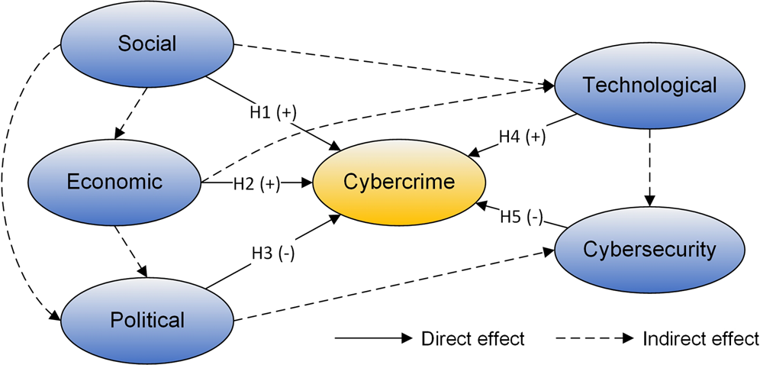
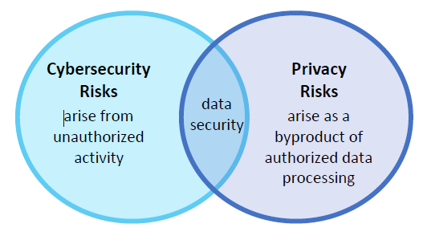
Cybersecurity VS Cybercrime…

Slide 7











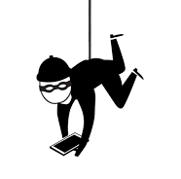
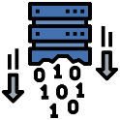





Cyber Threats faced by Organisations
Cybersecurity threats and risks come in different shapes and forms - these are just some of them to note for services
Threat Vectors
Threats
Misconfiguration
Contracts
Insider Threats
Ransomware
Malware
Botnet
Missing Security patches
Physical Access
Internet
(Drive-By-Downloads)
USB
Process bypass
User Device Theft
Data Loss/Theft
Vulnerable 3rd Party & Legacy Apps
Legacy Systems
Experts
Email
Identity/Credential Theft

Slide 8
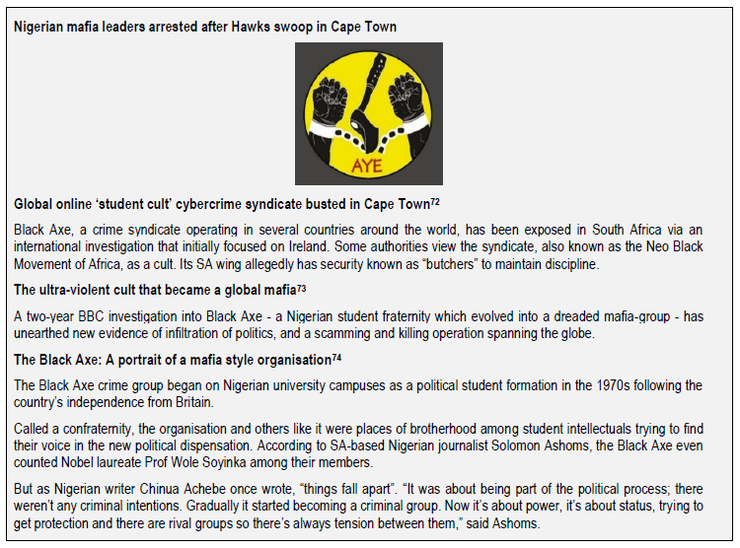
Cyber Threats faced by Organisations

Slide 9
Cybersecurity Breaches Business Impact
Cybersecurity breaches could have negative business impacts:
Financial Loss
Reputational Damage
Legal Implications
Loss of Intellectual Property
Business Loss
Business Disruptions
Notes:
Which of the negative business impacts do you worry the most about?

Slide 10

South African Case Studies:
Property Transfer Payment Scam
What happened: The seller of a property (Ms Judith Hawarden) appointed ENS Attorneys as the conveyancers after putting her property for sale for R6M through Pam Golding Properties. The seller received an email from ENS Secretary in the Property Division on finalisation the transfer. However, the e-mail had been intercepted and bank account and domain name details changed (ensafirca.com from ensafrica.com).
What was the impact: R5.5m was paid into fraudster’s account and law firm ordered by High Court in Gauteng to pay the victim R5.5m for being negligent and not using secure portal and/or e-mail for transaction.
What can you do to prevent similar incident: use secure e-mail for all financial transactions, monitor network and email for any breaches or suspicious behaviour, put processes in place to reduce risks of business email compromise.

Slide 11
Management Concepts in Cybersecurity: KING IV
In King IV, there is a great emphasis on organisational Boards taking on a more hands-on approach - periodically carrying out formal reviews of the competence of the organisation’s IT function.
Integration of people, technologies, information and processes across the organisation
Integration of technology and information risks into organisation-wide risk management
Arrangements for business resilience
Proactive monitoring of intelligence to identify and respond to incidents, including cyber-attacks and adverse social media events
Management of the performance of, and the risks pertaining to, third-party and outsourced service providers
Assessment of value delivered to the organisation through significant investments in technology and information, including the evaluation of projects throughout their life cycles and of significant operational expenditure
Responsible disposal of obsolete technology and information in a way that has regard to environmental impact and information security
Ethical and responsible use of technology and information
Compliance with relevant laws

Slide 12
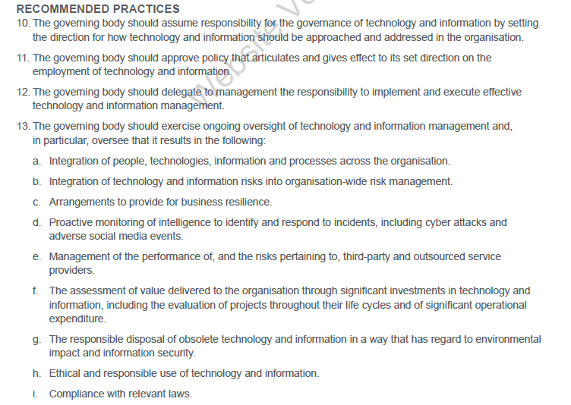
Management Concepts in Cybersecurity: KING IV

Slide 13
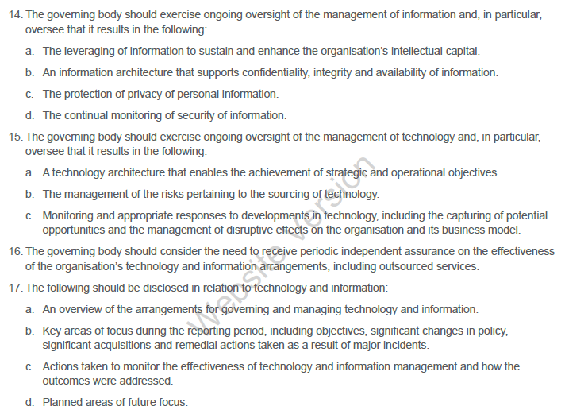
Management Concepts in Cybersecurity: KING IV

Slide 14


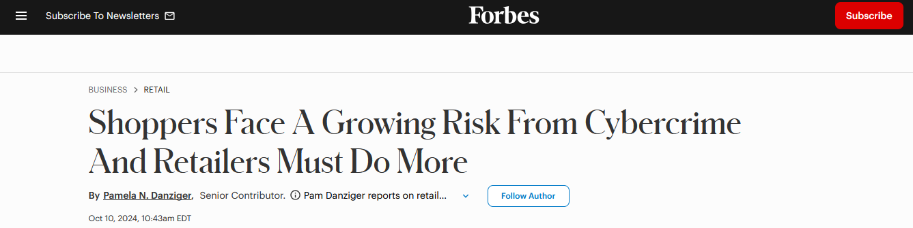
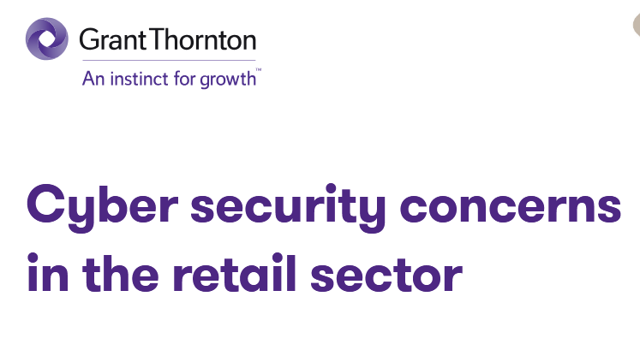
Cybersecurity in the retail sector….

Slide 15
Why Retail Cybersecurity Threats Happen
Retailers collect, process and store increasingly large amounts of customer data, including PII and credit card numbers.
Many retail businesses are a hybrid of brick-and-mortar and e-commerce. To manage this ecosystem, they use a mix of technologies (e.g. PoS in stores and cloud-based systems for e-commerce).
Use of Near Field Communications (NFC) for payments
Digital systems create new attack surfaces
Disintermediation increases security responsibility
Vendor risks extend exposure to 3rd parties
Software vulnerabilities;
Lack of point-to-point encryption (P2PE) in PoS systems;
Use of insecure third-party plugins.

Slide 16
Retail Cybersecurity Statistics
Phishing remains the primary attack vector in the retail industry, accounting for 58% of incidents. Attackers often use legitimate platforms, such as invoicing tools, to deliver phishing links, making it harder for victims to detect fraud​
Brute force methods were responsible for 92% of credential access attempts, highlighting how attackers frequently rely on systematic password-guessing tactics to gain unauthorized access.
16% of ransomware incidents targeted businesses in the food and beverage retail sector
The most prominent ransomware groups targeting the retail industry are Play and LockBit 2.0. (Trustwave)
Data breaches
Attacks on IoT devices, payment systems
Advanced Persistent Threats (APT)

Slide 17
Why Retail Cybersecurity Threats Happen
ENCRYPT ALL SENSITIVE DATA
Ideally, sensitive data (e.g. credit card numbers) should not be retained. However, if retention is a must, then all data must be encrypted, whether at rest or in transit.
SEGMENT THE RETAIL NETWORK
Keep POS details, PII and customer financial information safe. Network monitoring tools should monitor each segment for signs of lateral movement, APTs, and breach attempts.
PERFORM REGULAR DATA BACKUPS
DEPLOY POS MALWARE
An anti-malware solution must be implemented on the entire retail network, especially on POS systems. Timely security patches must also be implemented on all software and applications used by the company.
IMPLEMENT MULTI-FACTOR AUTHENTICATION (MFA)
To keep customer data safe from phishing attacks or account takeovers, MFA must be implemented. It’s also important to select an e-commerce platform that complies with the Payment Card Industry Data Security Standard (PCI-DSS).
IMPLEMENT ZERO-TRUST ACCESS (ZTA)
The ZTA approach controls user and device identity and access. Its “trust no one” philosophy can boost cybersecurity effectiveness for retailers.
SECURITY TRAINING

Slide 18
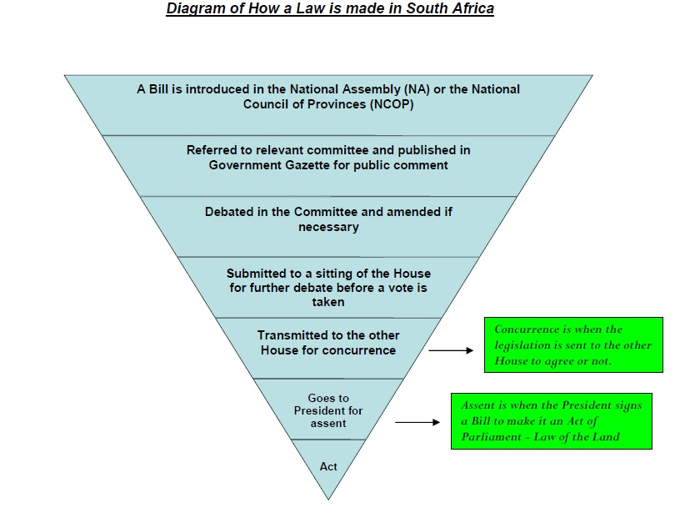
Legal Frameworks
Policy
National Cybersecurity Policy Framework
Legislation
Cybercrimes Act (originally as Cybercrimes and Cybersecurity Bill)
Cybersecurity Bill
POPIA
Film and Publications Board Child Protection
ECT Act, Criminal Procedures Act……
Regulation
Cybercrimes regulations and SOPs
….
Policies, strategies etc
National Policy on Data and Cloud, 2024

Slide 19
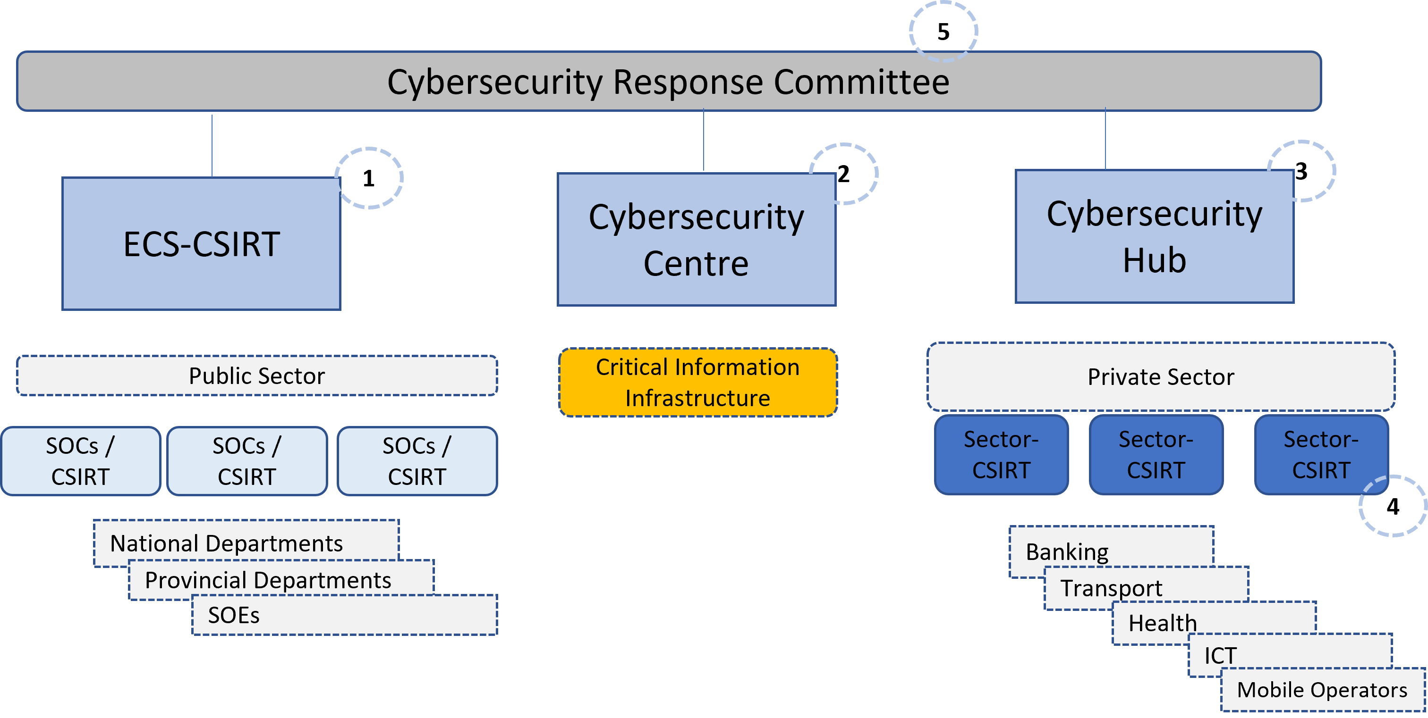
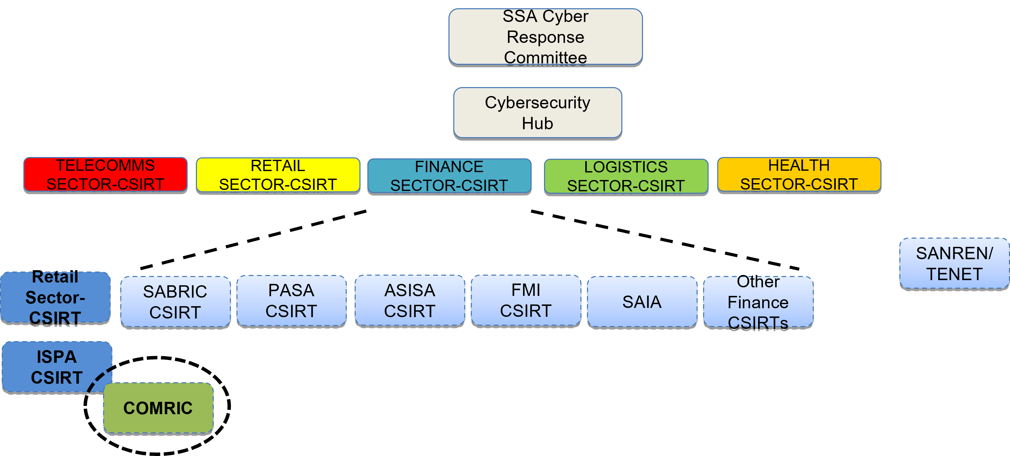
National Computer Security Incident Response Teams (CSIRTs)
Making South Africa a Global Leader in Harnessing ICTs for Socio-economic Development

Slide 20
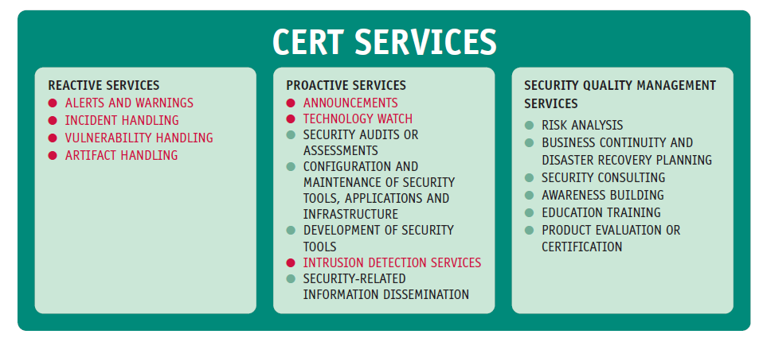
Technical Measures
"Computer Security Incident Response Team (CSIRT)"
  Team of dedicated information security specialists that prepares for and responds to Cybersecurity breaches or Cybersecurity incidents.
National CSIRTs act as the main national point of contact for domestic incident response stakeholders as well as other national CSIRTs around the world.
Sectoral CSIRTs serve a specific sector of society or the economy, such as the banking or education sector.
Organisational CSIRTs are tasked with monitoring and responding to incidents on the internal networks of the organization they reside in. They exist in private companies, government organisations and academic institutions.
Vendor CSIRTs are generally public-facing teams within vendors that produce IT used by individuals and companies. These teams provide operational support for commonly used products like commercial operating systems.
Commercial CSIRTs, or CSIRTs for hire, provide incident-handling services as a product to other organizations.
Regional CSIRTs and similar organizations connect national CSIRTs across borders at a regional level, and they serve two primary functions:
(1) enhancing cooperation between national CSIRTs and
(2) facilitating information sharing between CSIRTs in the region.

Slide 21
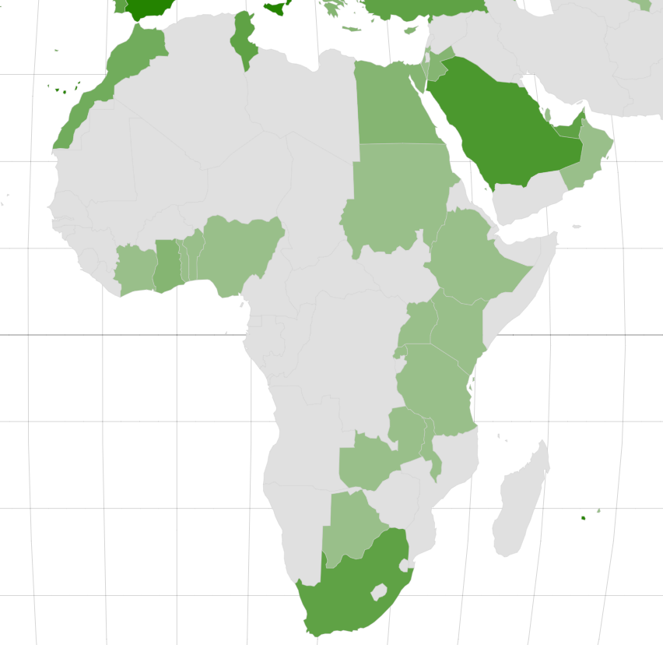
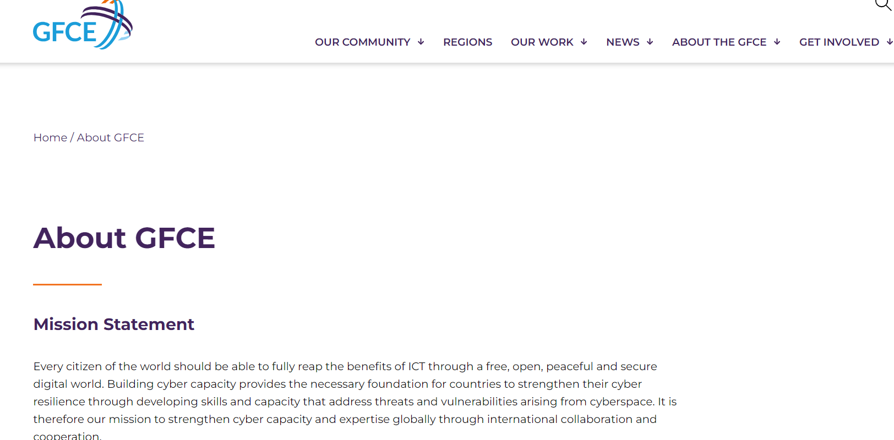

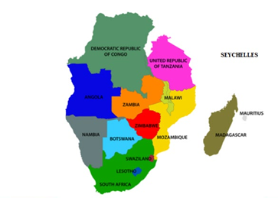
National Computer Security Incident Response Teams (CSIRTs)
Africa CERT is a forum for Computer Security Incident Response Teams (CSIRTs) and similar organizations across the African continent, fostering cooperation, promoting information sharing, and enabling a community of security professionals to work together.
Established the SADC Regional CIRT (SR-CIRT) Framework in September 2019 - A regional collaboration platform to strengthen the regional cybersecurity readiness, protection and incident response capabilities.
https://www.first.org/members/map
Making South Africa a Global Leader in Harnessing ICTs for Socio-economic Development

Slide 22
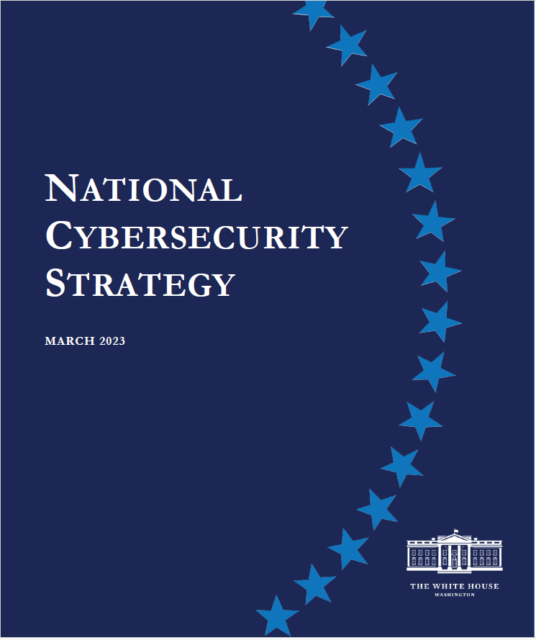
Organisational: National Strategies
We must hold the stewards of our data accountable for the protection of personal data; drive the development of more secure connected devices; and reshape laws that govern liability for data losses and harm caused by cybersecurity errors, software vulnerabilities, and other risks created by software and digital technologies. We will use Federal purchasing power and grant-making to incentivize security
Markets impose inadequate costs on—and often reward—those entities that introduce vulnerable products or services into our digital ecosystem. Too many vendors ignore best practices for secure development, ship products with insecure default configurations or known vulnerabilities, and integrate third-party software of unvetted or unknown provenance. Software makers are able to leverage their market position to fully disclaim liability by contract, further reducing their incentive to follow secure-by-design principles or perform pre-release testing. Poor software security greatly increases systemic risk across the digital ecosystem and leave American citizens bearing the ultimate cost.
We must begin to shift liability onto those entities that fail to take reasonable precautions to secure their software while recognizing that even the most advanced software security programs cannot prevent all vulnerabilities.

Slide 23
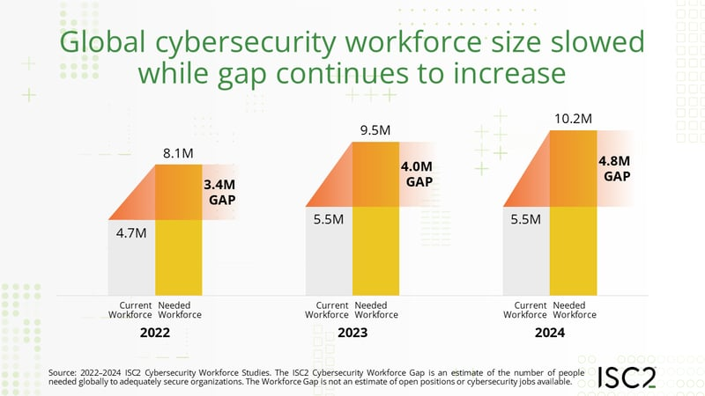
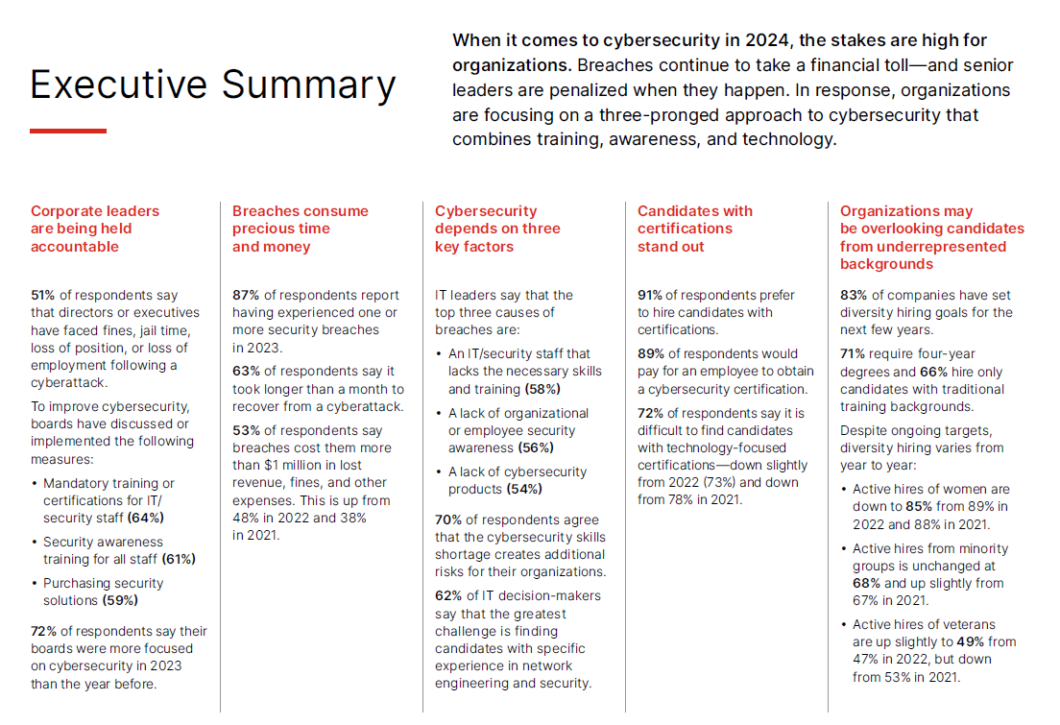
Capacity Building
Lack of distinct career paths
Outdated training
Costly certifications and job stress
Higher education institutions (HEIs), organisations and the South African government are not investing enough into cybersecurity skills development.
Size of the Active Cybersecurity Workforce: 5.5 million Globally (up 0.1% YoY)
Size of the Workforce Gap: 4.8 million Globally (up 19% YoY)
Total Workforce Needed to Satisfy Demand: 10.2 million Globally (up 8.1% YoY)

Slide 24
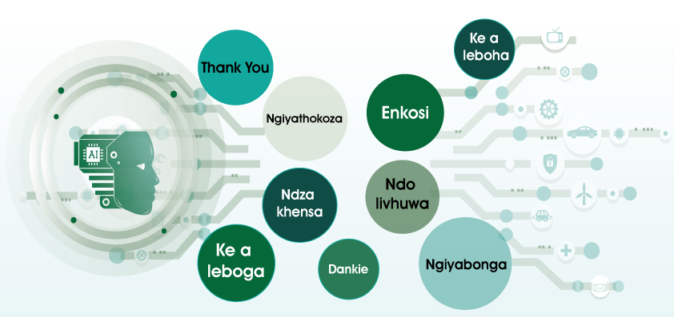
35

